Slide 1
What can genomics offer to those with rare genetic disorders?
John Christodoulou Director, Genetics Research Theme, Co-Head, Brain and Mitochondrial Research Group, Murdoch Children’s Research Institute
Chair of Genomic Medicine, Department of Paediatrics, University of Melbourne, Melbourne Australia
Co-Lead, Australian Genomics Health Alliance
27th November 2018

Slide 2
Summary of presentation
setting the scene
the promise of genomic medicine
can genomic medicine be delivered at a national level?
technical challenges on the horizon

Slide 3
Traditional diagnostic approach for suspected genetic disorders
clinical evaluation
biochemical screening tests
targeted biochemical tests
molecular karyotype (array CGH/SNP arrays)
imaging studies
biopsies – histology/EM
functional studies – enzymology etc
molecular genetic testing – one gene at a time
prolonged, expensive and intrusive diagnostic odyssey

Slide 4
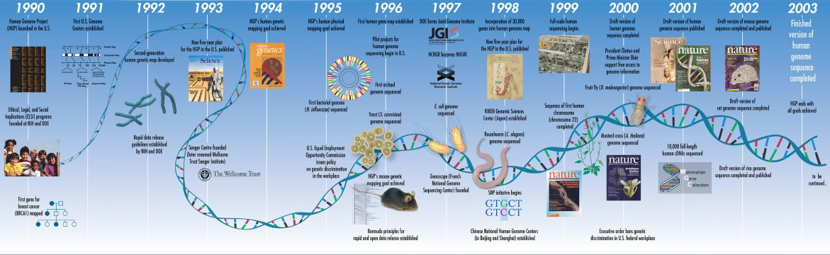
First human genome 2003
Source: Rare Cancers Australia & https://www.genome.gov/sequencingcostsdata/
>10 years, USD$3 billion

Slide 5
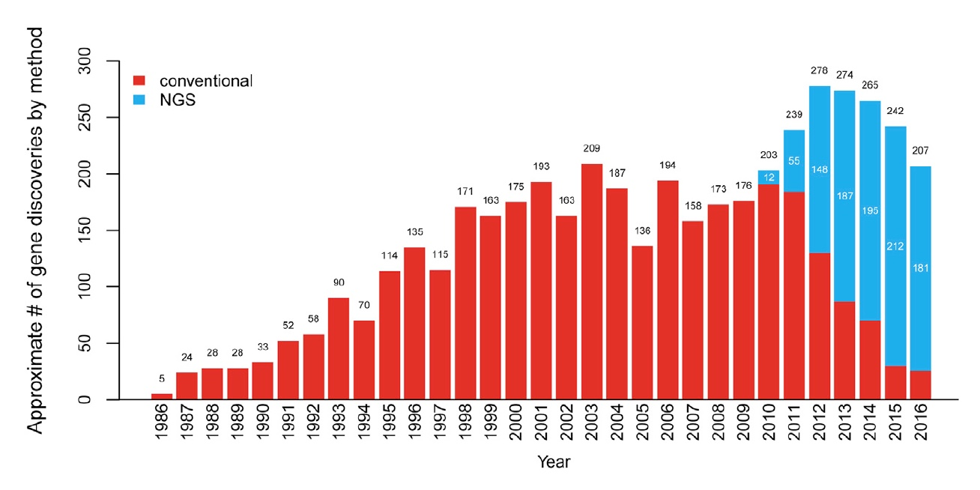
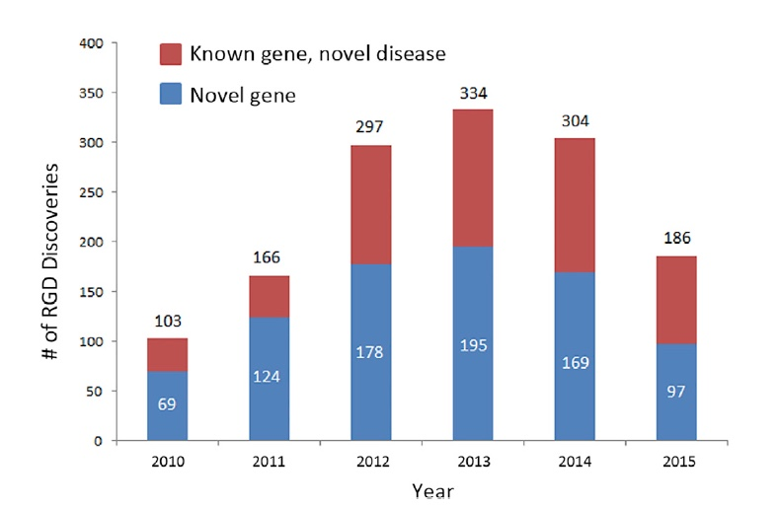
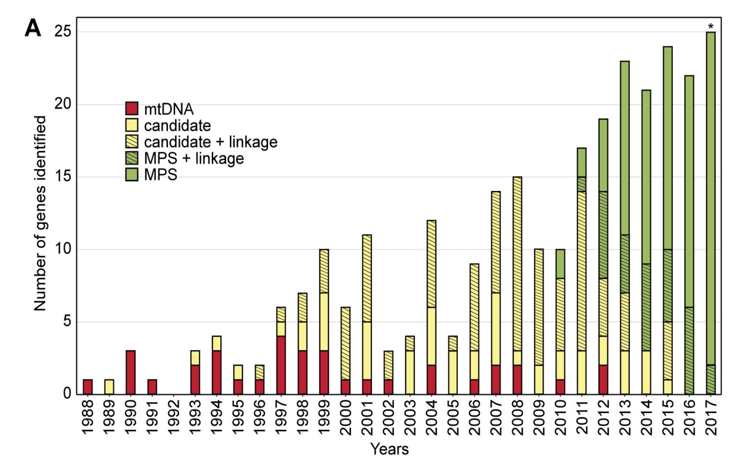
Monogenic disorder gene discovery is on the decline……
Boycott et al AJHG 2017: 100; 695-705
Frazier at al J Biol Chem 2018
…… or perhaps not ……

Slide 6

The promise of genomic medicine in healthcare
Notes:
Unparalleled generation of human genetic data
Learning from these data, we should accelerate progress in:
Understanding the basis of inherited disease
More rapid path to diagnosis
Increased emphasis on prevention, early intervention
Therapies targeted to the individual
Identifying targets for drug development
Complex common diseases

Slide 7


Early use of genomic testing provides most benefit
 | Usual care | WES
Diagnostic yield | 11% | 58%
Change in management | 4% | 16%
QALYs gained | 0 | 1.25
Cost per diagnosis | $27,050 | $10,788
80 infants with
?monogenic conditions
2014-15
Diagnosis N=48
(19%)
No diagnosis N=32
(3%)
18 months later…
A diagnosis restores reproductive confidence
* Stark et al (2016,2017) Genet. Med.

Slide 8



Standard vs Rapid Genomics
 | Standard 2014-2015 N=80 | Rapid 2016-2017 N=40
Test time | 136 days (71-277) | 16 days (9-109)
Result during first hospital admission | 0 | 78%
Diagnostic yield | 58% | 52%
Clinical utility | 34% | 57%
Cost per diagnosis | $10,788 | $13,388
Cost savings | $16,206 | $543,178
Melbourne Genomics Health Alliance | Stark et al, 2018

Slide 9

Early and FAST diagnosis matters
5mo hypotonia and seizures
9 months of investigations = $11,928
Clinical diagnosis: Leigh syndrome, fatal
Genomic diagnosis: thiamine transporter defect
Treatable: thiamine $0.40 per day
No further deterioration
Asymptomatic sister diagnosed, remains well

Slide 10
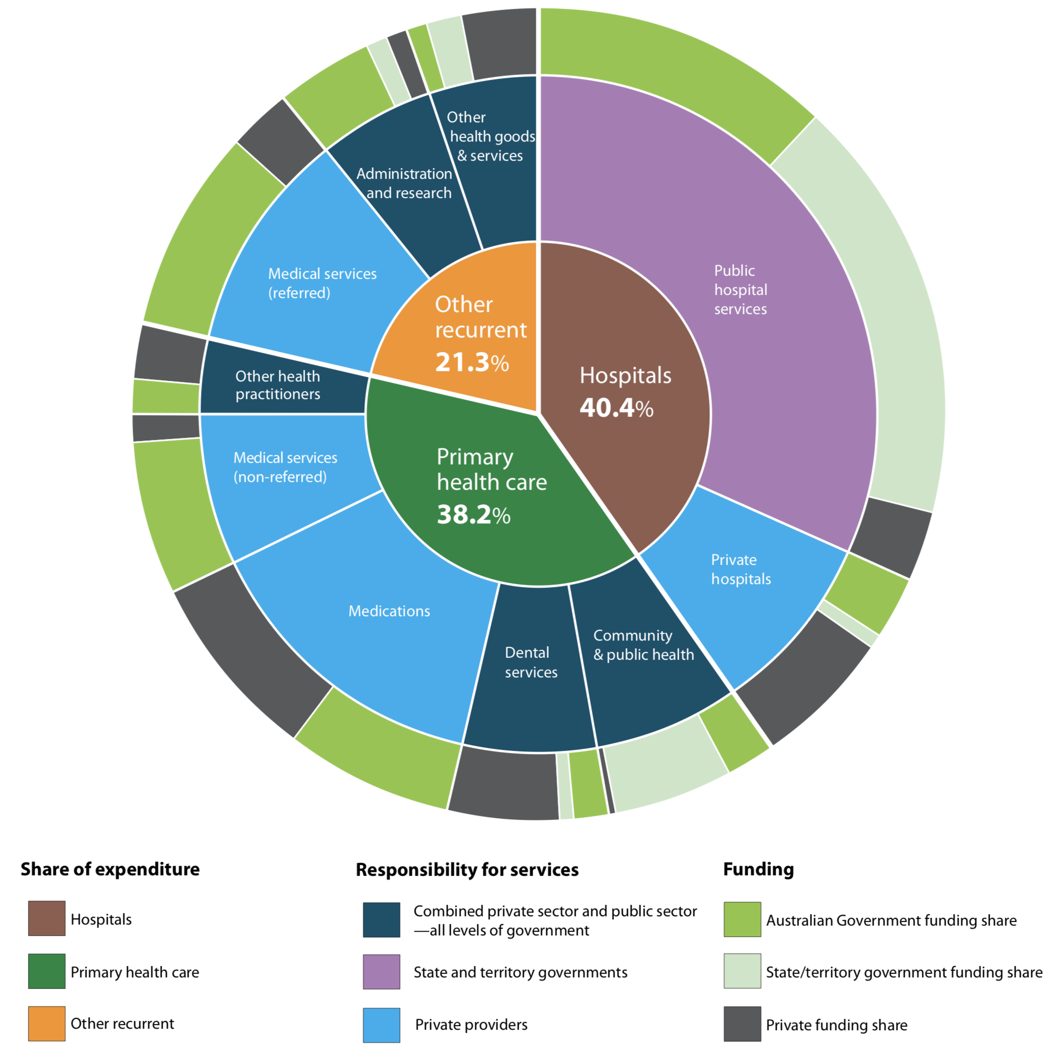
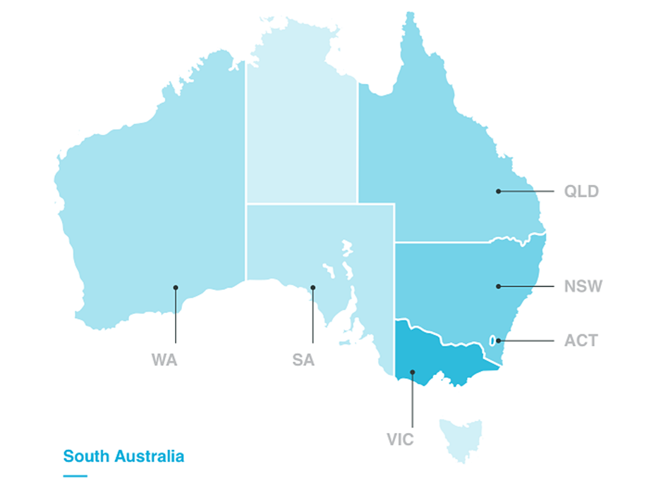
The Australian Health Care System COMPLEX AND FRAGMENTED STRUCTURE
Health service funding and responsibilities
Australia’s Health 2014, AIHW

Slide 11

Australian Genomics Health Alliance
Our Origins: Targeted Call For Research Grant $25M NATIONAL HEALTH AND MEDICAL RESEARCH COUNCIL GRANT (2016-2020)
Australian Genomics aims to demonstrate the cost effectiveness, diagnostic efficacy and impact on clinical care of genomic medicine
To demonstrate how patient benefit could be maximized through application of genomic data in one or more human diseases.
To provide evidence to inform analysis on the cost effectiveness of implementing genomic data into the Australian health system.
To increase understanding of practical strategies that could be used by Australian health system planners and policymakers.
To build Australia’s research and research translation capacity in the area of genomics and healthcare.

Slide 12
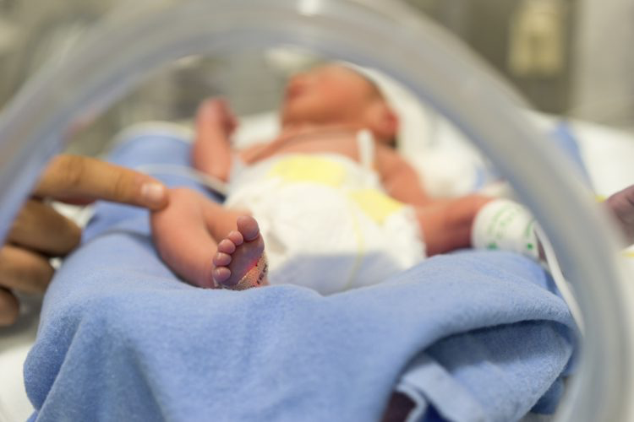

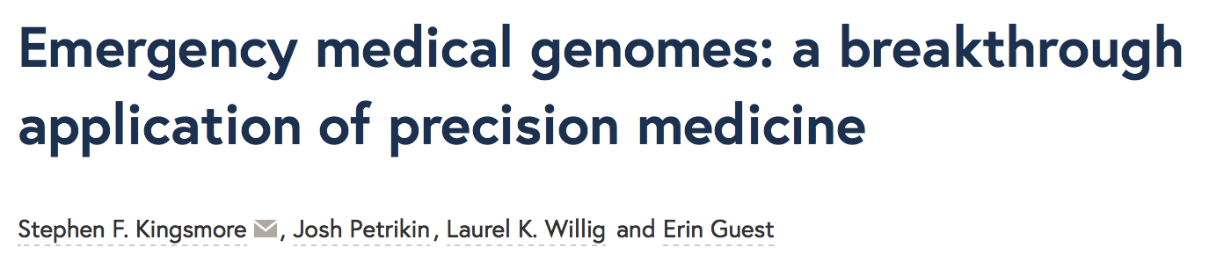


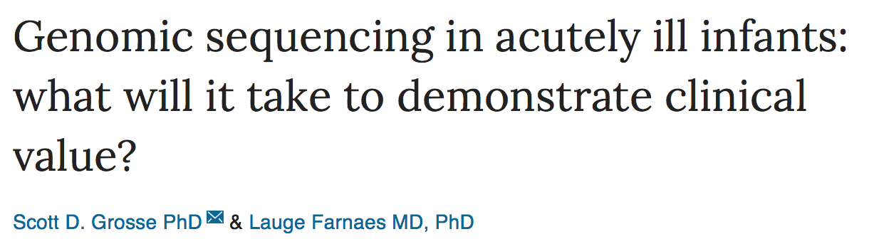
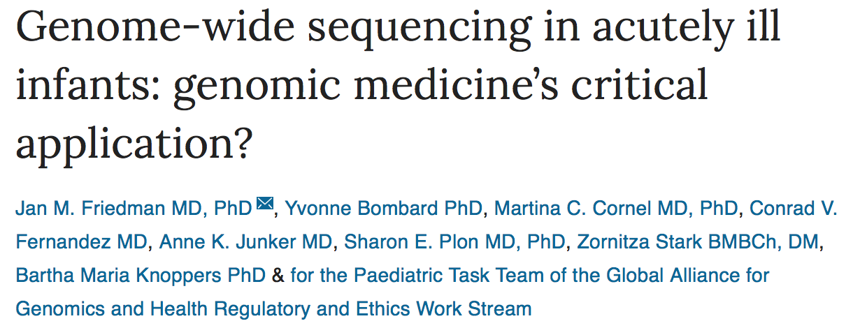

~5% of NICU admissions have underlying genetic condition
Need to match the acuity
of the clinical situation
Decisions made over
minutes/hours/days
NOT months/years
Ventilated patient
$4,500 per day
19hrs

Slide 13
Australian Genomics Acute Care Flagship – launched in 2018
Approach: Providing ultra-rapid (<5 day) genomic testing to acutely unwell infants and children with suspected genetic conditions, with the aim of providing diagnostic certainty and guiding acute care management
Goals:
Establish clinical and laboratory pathways to deliver ultra-rapid genomic testing
Comprehensive interdisciplinary evaluation of ultra-rapid genomic testing in acute paediatrics

Slide 14


Australian Genomics Acute Care Genomics Flagship, N = 70
SYND | METABOL | NEURO | OTHER
PTPN11 (3) | TANGO2 | ELP2 | ABCC6
RIT1 | mtDNA (2) | GRIN2A | CRYAB
NF1 | LARS2 | SCN1A | KCNJ1
SMARCB1 | ECHS1 | STXBP1 | SPINK5
CHD7 | ATP7A | GLRB | TGM1
RET | ALG1 | RYR1 | PHOX2B
GATA3 | PPP1R21 | COLQ
TAF1 | PCCA | MYMK
SOX11 | HSD17B10
HUWE1
Diagnostic yield 35/70= 50%
Average TAT 79hrs
(48hrs-167hrs)
50-60% change in management
50% of diagnoses have high recurrence risk

Slide 15
Beyond the exome – the hard(er) stuff!
phenotypic expansion (~18% of genes) and blended phenotypes (~5-8% of cases)
tractable bioinformatics/curation challenge - pushing the limits of expert systems?
manual curation and clinical experts needed
non-coding variants and monogenic disease
combined WGS and RNA-seq – variants affecting splicing; variants in regulatory regions (5’UTR, 3’UTR, ncRNA)
oligogenic inheritance (ciliopathies; autism??; mitochondrial disorders??)
mitochondrial respiratory chain disorders as a test model?
tandem repeats & human disease (mutation rate orders of magnitude > SNV)
noncoding TR as direct or indirect transcriptional regulators? Alter DNA or RNA structure? Contributors to missing heritability in polygenic disorders or endophenotypes? What about somatic mutation? Epigenetic overlay??

Slide 16
Conclusions
NGS is the most disruptive new technology this decade in medical practice
health economic assessments to date very robust
great opportunities but many risks
responsible delivery of genomic medicine will need to be tailored for the local healthcare environment
early engagement with all stakeholders is critical
a wonderful time to be working in clinical genetics!

Slide 17


Thank you

Slide 18





Rapid diagnosis programs: single centre experience
Farnaes et al 2018
Trio WGS
N=42
Median TAT 7d
Diagnosis 43%
Meng et al 2017
Trio WES
N=62
Mean TAT 13d
Diagnosis 50.8%
Clinical utility 30-60% of those diagnosed
Boukhibar et al 2018
Trio WGS
N=24
Median TAT 7d
Diagnosis 42%
Stark et al 2018
Singleton WES
N=40
Median TAT 16d
Diagnosis 52%

Slide 19



Australian Genomics Acute Care Flagship – launched in 2018
Many Questions….
Lots of Challenges…
Barriers to implementation?
Approach: Providing ultra-rapid (<5 day) genomic testing to acutely unwell infants and children with suspected genetic conditions, with the aim of providing diagnostic certainty and guiding acute care management
Clinical service delivery model?
Consistency
How do we deliver<5d TAT?
Is consent meaningful?
Sequencers
Consent
24/7 work cycle
Which patients to test?
Communication
IT
Goals:
Establish clinical and laboratory pathways to deliver ultra-rapid genomic testing
Comprehensive interdisciplinary evaluation of ultra-rapid genomic testing in acute paediatrics
Cost effectiveness?
Supporting families
Team capacity
How do results impact decisions?
Logistics
Is this fair use of resources?
Diagnostic utility?
Workloads
Clinical utility?
Cost
With thanks to Zornitza Stark

Slide 20


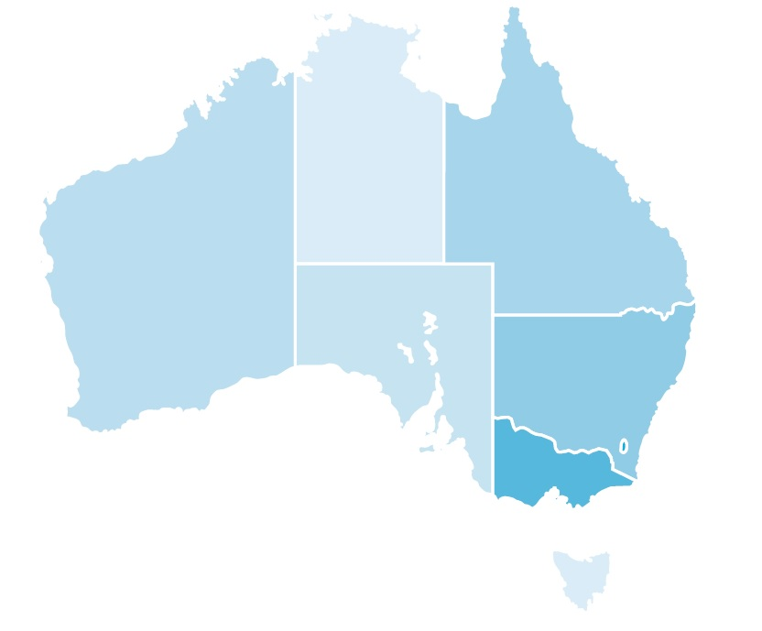

11 Hospitals
8 Genetic Services
11 NICUs (Level 3)
6 PICUs
<5 day TAT
Royal Brisbane and Women’s
Lady Cilento Children’s Hospital
Westmead (Adult)
John Hunter
Prince of Wales
Royal Prince Alfred
Sydney Children’s Hospital Network
Women’s and Children’s
Royal Hospital for Women
Monash Children’s
Royal Children’s Hospital
Royal Women’s Hospital

Slide 21
Acute Care Genomics Flagship, N=70
Inclusion criteria
NICU/PICU patient
Likely monogenic disorder
Other inpatients: clinical utility
Exclusion criteria
Secure clinical diagnosis
Non-monogenic cause likely
Imminent discharge/death
All cases approved by national panel
John Christodoulou, Meredith Wilson, Jason Pinner, Chirag Patel, Zornitza Stark, Chris Barnett
Considered N=83
Approved N=77
Declined N=6
Tested N=70
Withdrawn N=7
Average time to approval 130 min (10-756)

Slide 22
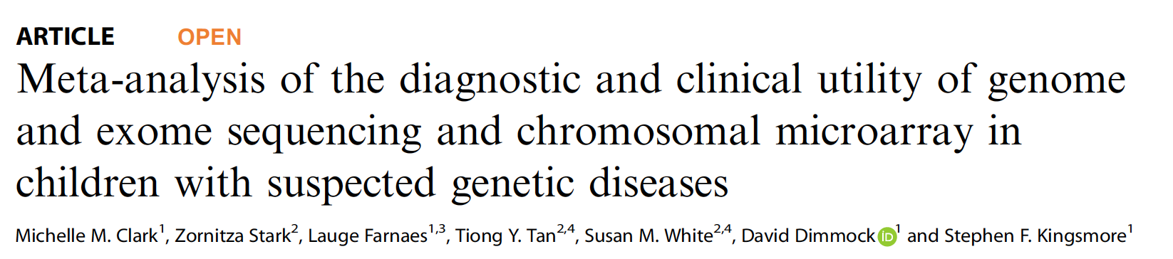
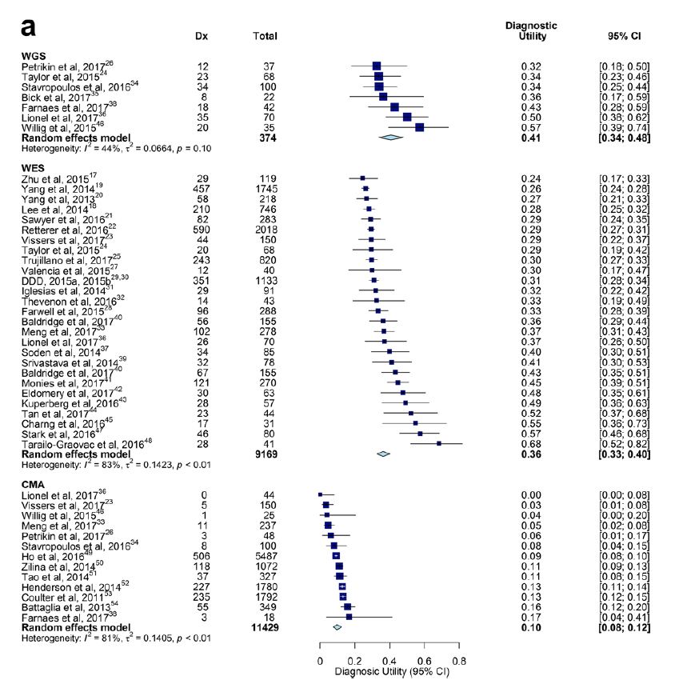
The revolution in rare disease diagnosis
37 studies, >20,000 paediatric patients
WES/WGS are x 3-4 more diagnostically effective than chromosomal microarray

Slide 23
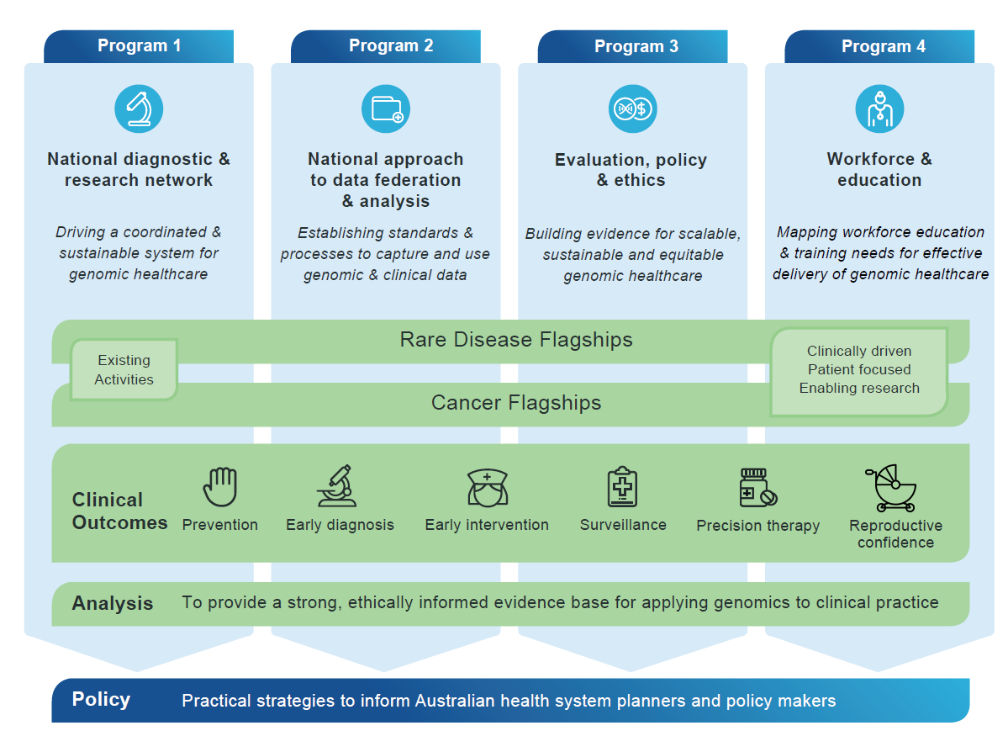

Australian Genomics NATIONAL HEALTH SERVICES RESEARCH PROGRAM
Notes:
Our four Programs are examining the needs of our health-system to adapt to, and implement, genomic medicine …while our 17 Cancer and Rare Disease Flagships serve as demonstrations of the use of genomic medicine in clinical practice …
To maximise our impact and ensure a judicious use of resources, many of our Programs and Flagships leverage existing research, with Australian Genomics funding allowing the expansion of scope and activity. The contributions and collaboration of partner organisations is essential to the application of our research.

Slide 24
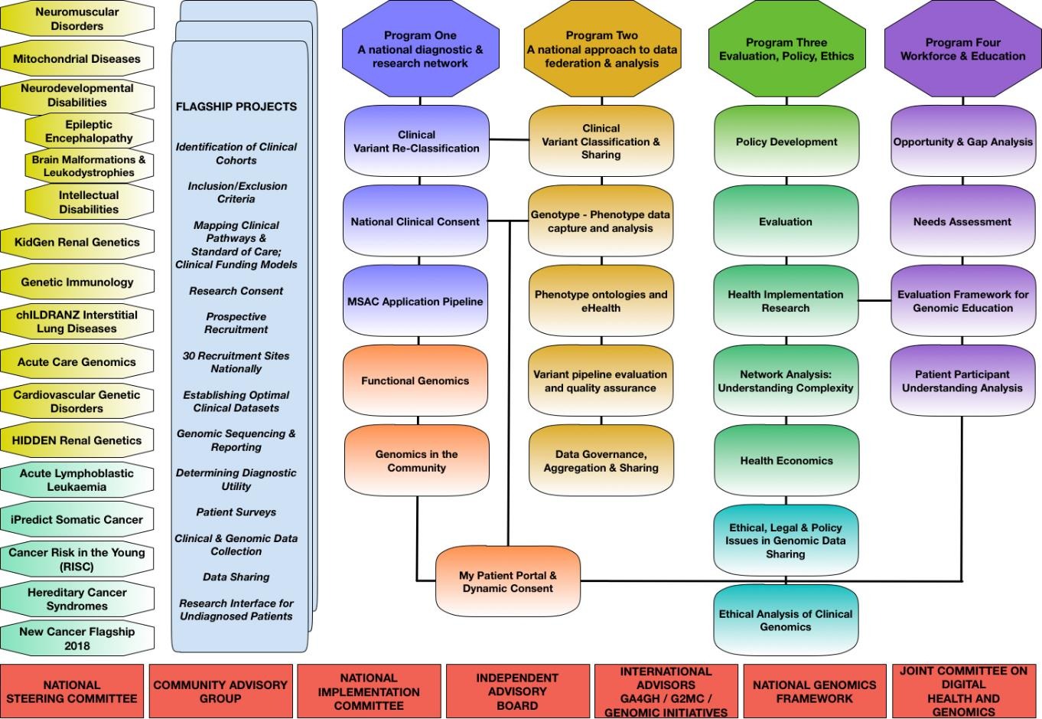
Australian Genomics PROGRAMS, FLAGSHIPS AND PROJECTS

Slide 25

Acute Care Flagship
Clinical Lead: Zornitza Stark
VIC: John Christodoulou, Emma Krzesinksi, Matthew Hunter, Sue White, Tiong Tan, Katherine Howell, Lauren Akesson, Andrew Fennell, Chris Richmond, Smitha Kumble, Joy Lee, Heidi Peters, Michelle De Silva, Sam Ayres, Gemma Brett, Ivan Macciocca, Lyndon Gallagher
NSW: Jason Pinner, Sarah Sandaradura, Meredith Wilson, Kirsten Boggs
QLD: Chirag Patel, Michael Quinn, Jonathan Rogers, Megan Higgins, Lauren Hunt, Lindsay Fowles, Sarju Mehta, Di Milnes, Pathology QLD
SA: Christopher Barnett, Sarah King-Smith
Laboratory Lead: Sebastian Lunke
VCGS Pathology: Belinda Chong, Dean Phelan, Miriam Fanjul-Fernandez, Justine Marum, Vanessa Siva Kumar, Jessica Riseley, Steffi Eggers, Simon Sadedin, Chris Ieng, Damien Zammit, Maelle Le Moing, Zeliha Hizli, David Thorburn
Randwick Pathology: Michael Buckley, Tony Roscioli, Edwin Kirk
Australian Genomics:
Tiffany Boughtwood, Keri Pereira, Matilda Haas, Jade Caruana, Tessa Mattiske, Dotti Tang
Evaluation
Workforce/education: Clara Gaff, Belinda McClaren, Amy Nisselle, Fiona Lynch, Melissa Martyn
Health economics: Ilias Goranitis
Ethics: Julian Savulescu, Ainsley Newson, Chris Gyngell, Dominic Wilkinson
Implementation science:
Stephanie Best, Janet Long, Jeffrey Braithwaite
Family surveys: Melissa Martyn

Slide 26
Next 5 years
Basic Research
Public Health
Clinical Research
Impact
Towards Precision Child Health
“Big Data”
Approach to discover and develop medicines, vaccines or routes of intervention that enable disease prevention and deliver superior therapeutic outcomes for patients,
by integrating ‘big data’ –
clinical, multi-omics, environmental and behavioural information –
to understand the biological basis of disease.

Slide 27
The genomics journey
Pre-test care
Clinician Tools
Patient Tools
Automated analysis
Analysis platform
Classification & Reporting
Curation tool
Data
Genome data repository
Post-test care
Clinician Tools
Patient Tools
From Melbourne Genomics Health Alliance

